Slide 1
Jelly Script

Slide 2
1. What is Jelly
Jelly is nothing but the Java Elements comprised of Java and XML-based scripting that originates from Apache Foundation.
ServiceNow uses Jelly Scripting to process XML-based documents containing static and dynamic HTML content and special Jelly Tags and the output is HTML.
Notes:
https://medium.com/@aakashgarg3108/introduction-to-servicenow-jelly-scripting-509a51c64147

Slide 3
1. What is Jelly
There are 2 kinds of tags in Jelly Scripting
Core Tags — known as Jelly Core.
  Example:- <j:set>, <j:choose>, <j:if>, <j:forEach>, <j:otherwise>
ServiceNow Custom Tags — known as Glide Core.
  Example:- <g:ui_form>, <g:evaluate>, <g:ui_reference>
However, you will find practical examples using both tags in this blog that help you to get started with Jelly Scripting. So, Stay Tuned!
Notes:
https://medium.com/@aakashgarg3108/introduction-to-servicenow-jelly-scripting-509a51c64147

Slide 4
2. Why learn Jelly?
ServiceNow uses Jelly Scripting a lot. There are 2 prominent places where ServiceNow uses Jelly Scripting.
UI Macros.
UI Pages.
UI Macros consist of Jelly Scripting only. However, we can induce Client Script in Jelly Script as well.
UI Pages consist of Jelly Script, Client Script, and Processing Script.
Notes:
https://medium.com/@aakashgarg3108/introduction-to-servicenow-jelly-scripting-509a51c64147

Slide 5
2. Why learn Jelly?
How to use it?
ServiceNow uses Formatters to place UI Macros (consisting of Jelly Scripting) in Forms.
To access or use UI Pages, There are 2 ways:-
Open UI Page directly using URI — https:<instance_name.service-now.com/<ui_page_name>.do
Open UI Page as a modal on the Client Side [using Client Script, UI Actions, etc.]
Notes:
https://medium.com/@aakashgarg3108/introduction-to-servicenow-jelly-scripting-509a51c64147

Slide 6
2. Why learn Jelly?
How to use it?
ServiceNow uses Formatters to place UI Macros (consisting of Jelly Scripting) in Forms.
To access or use UI Pages, There are 2 ways:-
Open UI Page directly using URI — https:<instance_name.service-now.com/<ui_page_name>.do
Open UI Page as a modal on the Client Side [using Client Script, UI Actions, etc.]
Notes:
https://medium.com/@aakashgarg3108/introduction-to-servicenow-jelly-scripting-509a51c64147

Slide 7
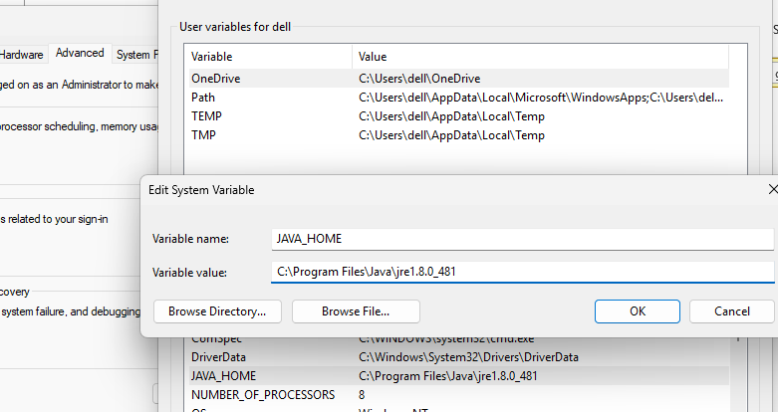
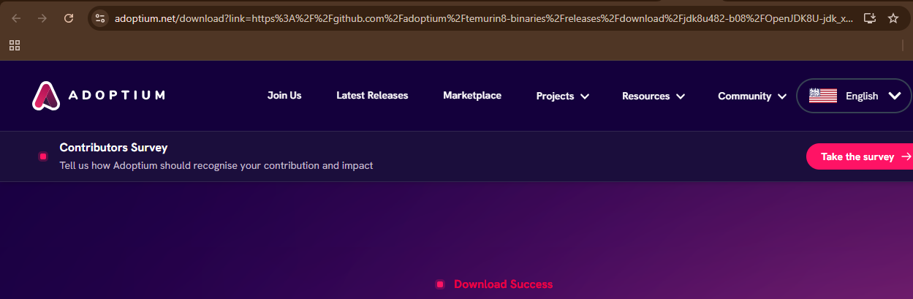
3. Install Jelly
First we need to install java from oracle
I will use java 8
https://www.java.com/en/download/manual.jsp
https://adoptium.net/temurin/releases/?version=8
Then in environment system variable we will add JAVA_HOME
Notes:
https://medium.com/@aakashgarg3108/introduction-to-servicenow-jelly-scripting-509a51c64147
https://commons.apache.org/proper/commons-jelly/

Slide 8
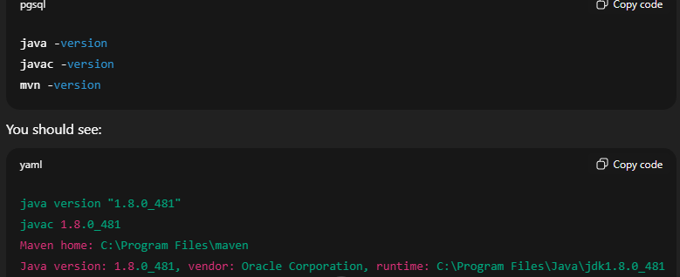
3. Install Jelly
First we need to install java from oracle
I will use java 8
https://www.java.com/en/download/manual.jsp
https://adoptium.net/temurin/releases/?version=8
Then in environment system variable we will add JAVA_HOME
Notes:
https://medium.com/@aakashgarg3108/introduction-to-servicenow-jelly-scripting-509a51c64147
https://commons.apache.org/proper/commons-jelly/

Slide 9
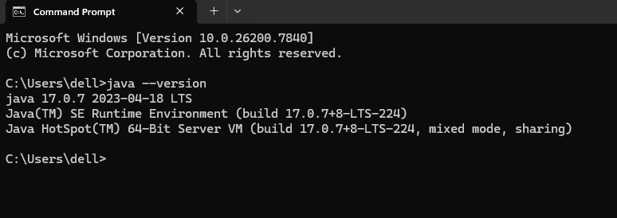
3. Install Jelly
To make sure that java is running
Open cmd and run java --version
Notes:
https://medium.com/@aakashgarg3108/introduction-to-servicenow-jelly-scripting-509a51c64147
https://commons.apache.org/proper/commons-jelly/

Slide 10
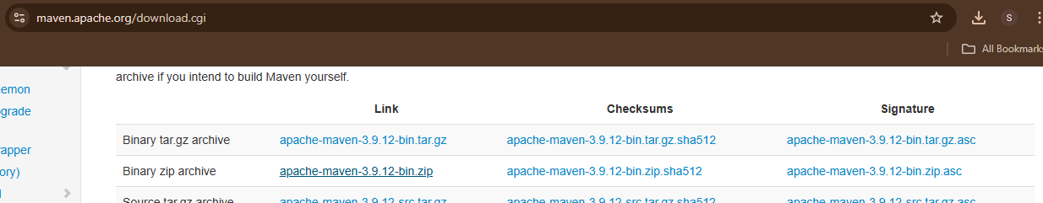
3. Install Jelly
Then we will download maven to can run any jelly script
https://maven.apache.org/download.cgi
Notes:
https://medium.com/@aakashgarg3108/introduction-to-servicenow-jelly-scripting-509a51c64147
https://commons.apache.org/proper/commons-jelly/

Slide 11
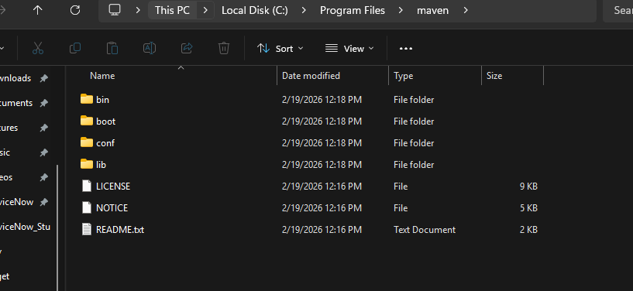
3. Install Jelly
Then create folder in C:\Program Files called maven and copy the extracted from zip
Add in enviroment system the path of maven to make run mvn command
Notes:
https://medium.com/@aakashgarg3108/introduction-to-servicenow-jelly-scripting-509a51c64147
https://commons.apache.org/proper/commons-jelly/

Slide 12
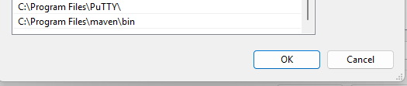
3. Install Jelly
Then create folder in C:\Program Files called maven and copy the extracted from zip
Add in enviroment system the path of maven to make run mvn command
Notes:
https://medium.com/@aakashgarg3108/introduction-to-servicenow-jelly-scripting-509a51c64147
https://commons.apache.org/proper/commons-jelly/

Slide 13
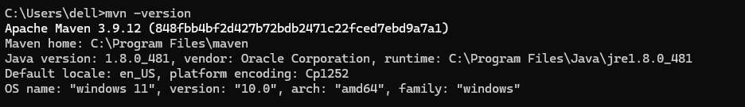
3. Install Jelly
To make sure that is maven is running open CMD
Mvn –version
Also that show the java is running in Maven
May be need to restart your PC to make sure everything is running
Notes:
https://medium.com/@aakashgarg3108/introduction-to-servicenow-jelly-scripting-509a51c64147
https://commons.apache.org/proper/commons-jelly/

Slide 14
3. POM FILE
In the context of JellyScript, a POM file usually refers to the same concept used in the Java ecosystem: a Project Object Model (POM) file used by Apache Maven.
What is a POM file?
A POM file is an XML file named:
It defines:
  Project metadata (name, version, description)
  Dependencies (external libraries your project needs)
  Build configuration
  Plugins
  Packaging type
  Repository information
Notes:
https://medium.com/@aakashgarg3108/introduction-to-servicenow-jelly-scripting-509a51c64147
https://commons.apache.org/proper/commons-jelly/

Slide 15
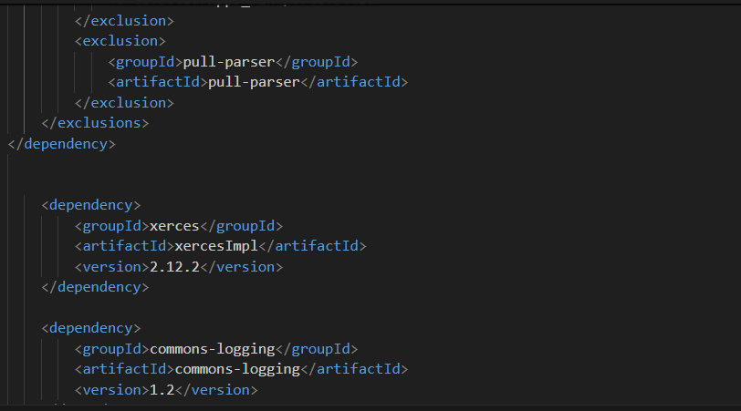
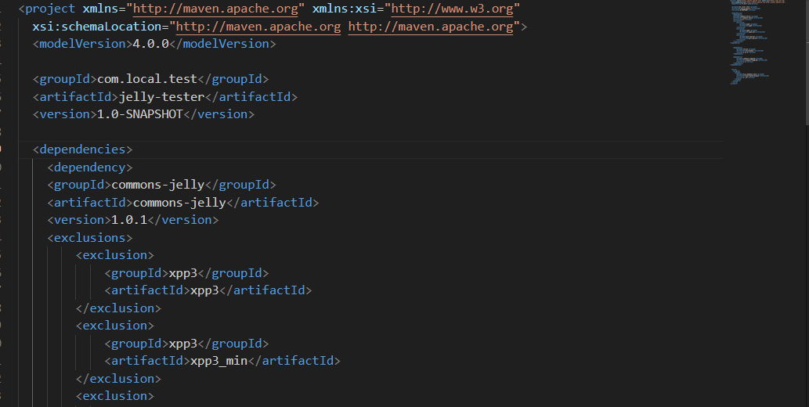
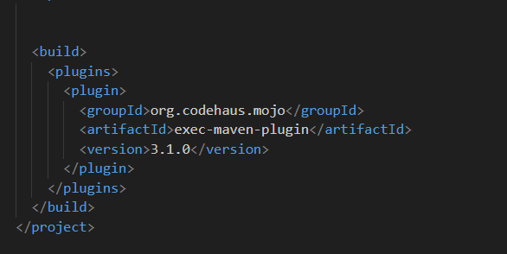
3. POM FILE
Notes:
https://medium.com/@aakashgarg3108/introduction-to-servicenow-jelly-scripting-509a51c64147
https://commons.apache.org/proper/commons-jelly/

Slide 16
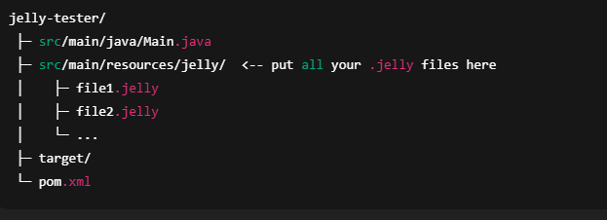
3. Install Jelly
To make build for all .jelly file
Create file Main.java
Notes:
https://medium.com/@aakashgarg3108/introduction-to-servicenow-jelly-scripting-509a51c64147
https://commons.apache.org/proper/commons-jelly/

Slide 17
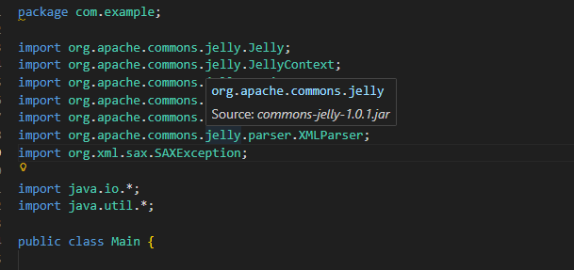
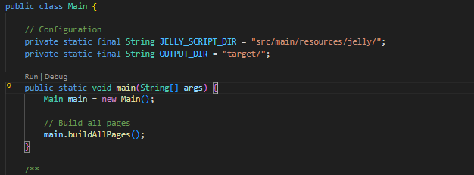
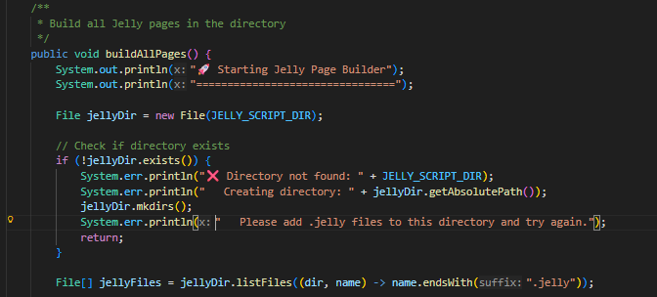
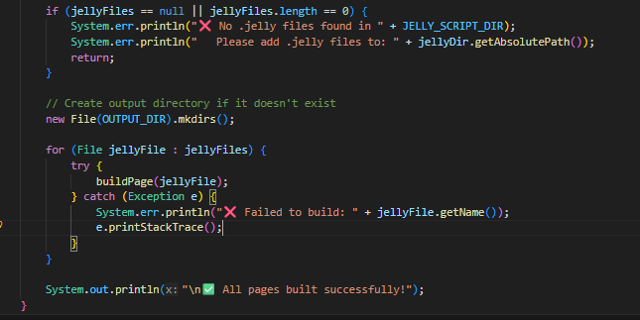
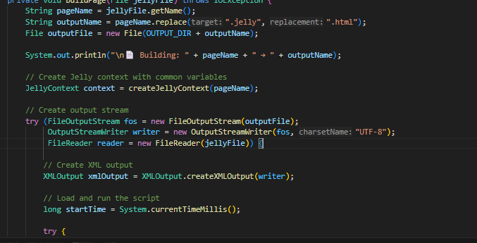
3. Install Jelly
Main.java File
Notes:
https://medium.com/@aakashgarg3108/introduction-to-servicenow-jelly-scripting-509a51c64147
https://commons.apache.org/proper/commons-jelly/

Slide 18
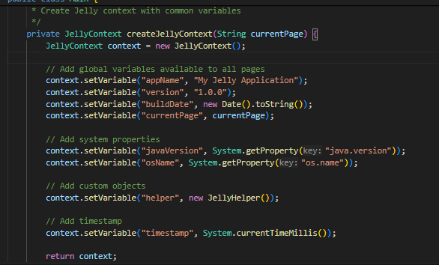
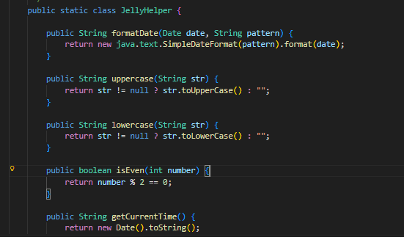
3. Install Jelly
Main.java File
Notes:
https://medium.com/@aakashgarg3108/introduction-to-servicenow-jelly-scripting-509a51c64147
https://commons.apache.org/proper/commons-jelly/

Slide 19
3. Install Jelly
Some Command may you will need it in mvn
Mvn clean
mvn exec:java -Dexec.mainClass=org.apache.commons.jelly.Jelly -Dexec.args=“your_script.jelly -o target/page.html“ to make it out as html file
mvn clean compile exec:java "-Dexec.mainClass=Main“ → To build many files .jelly
Notes:
https://medium.com/@aakashgarg3108/introduction-to-servicenow-jelly-scripting-509a51c64147
https://commons.apache.org/proper/commons-jelly/

Slide 20
JellyScript Syntax
How to define variable
<j:set var="jvar_sys_id" value="${sysparm_sysid}">
</j:set>
<h1>${jvar_sys_id}</h1>
Notes:
https://medium.com/@aakashgarg3108/introduction-to-servicenow-jelly-scripting-509a51c64147

Slide 21
JellyScript Syntax
jelly:core : The core Tags from the JSTL plus Jelly extensions.
Tag | Purpose
choose | Conditional block to choose among multiple conditions. (commons.apache.org)
when | Used inside choose to test a condition. (commons.apache.org)
otherwise | Fallback inside choose if no when matches. (commons.apache.org)
if | Conditional evaluation of body when test is true. (commons.apache.org)
switch | Switch/Case control structure. (commons.apache.org)
case | A switch case. (commons.apache.org)
default | Default section of a switch. (commons.apache.org)
break | Breaks out of a loop. (commons.apache.org)
while | Loop while condition is true. (commons.apache.org)
forEach | Loop over items like arrays or lists. (commons.apache.org)
Notes:
https://medium.com/@aakashgarg3108/introduction-to-servicenow-jelly-scripting-509a51c64147
https://commons.apache.org/proper/commons-jelly/tags.html

Slide 22
JellyScript Syntax
1-Print Hello World.
<?xml version="1.0" encoding="utf-8" ?>
<jelly>
<html>
<body>
<h1>Hello World from Jelly!</h1>
<p>This page was generated locally.</p>
</body>
</html>
</jelly>
Notes:
https://medium.com/@aakashgarg3108/introduction-to-servicenow-jelly-scripting-509a51c64147

Slide 23
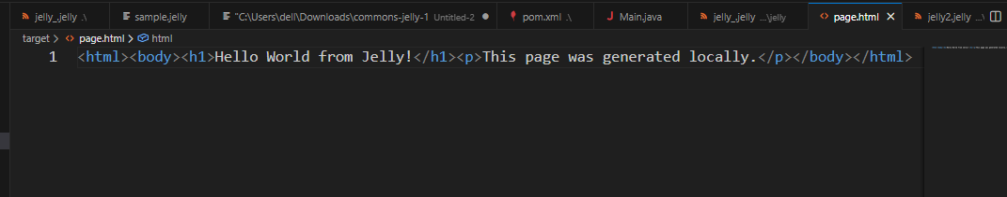
JellyScript Syntax
To genenarte as html
mvn exec:java "-Dexec.mainClass=org.apache.commons.jelly.Jelly" "-Dexec.args=your_script.jelly -o target/page.html"
Output:
Notes:
https://medium.com/@aakashgarg3108/introduction-to-servicenow-jelly-scripting-509a51c64147

Slide 24

JellyScript Syntax
2. Print an Array.
var words = ["Welcome", "To", "Jello", "World"]
<?xml version="1.0" encoding="utf-8" ?>
<j:jelly xmlns:j="jelly:core" xmlns:g="glide">
<!-- In servicenow -->
<!-- <g:evaluate>
var words = ["Welcome", "To", "Jello", "World"];
</g:evaluate>
<j:forEach var="jvar_msg" items="${words}">
<p>${jvar_msg}</p>
</j:forEach> -->
<!-- In standard Jelly, you can define an array using a comma-separated string
or by passing a Java object from your Maven 'exec' context -->
<j:set var="words" value="Welcome,To,Jello,World"/>
<!-- Use tokenize to split the string into a list for the loop -->
<j:forEach var="jvar_msg" items="${words.split(',')}">
<p>${jvar_msg}</p>
</j:forEach>
</j:jelly>
Output:
Notes:
https://medium.com/@aakashgarg3108/introduction-to-servicenow-jelly-scripting-509a51c64147

Slide 25
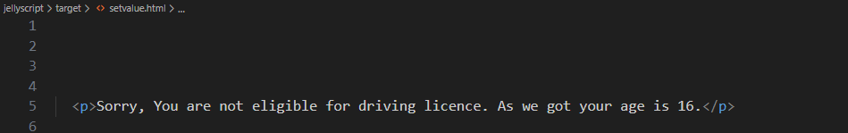
JellyScript Syntax
3. Variable and with condition
<?xml version="1.0" encoding="utf-8" ?>
<j:jelly trim="false" xmlns:j="jelly:core" xmlns:g="glide" xmlns:j2="null" xmlns:g2="null">
<j:set var="jvar_age" value="16">
</j:set>
<j:if test="${jvar_age lt 18}">
<p>Sorry, You are not eligible for driving licence. As we got your age is ${jvar_age}.</p>
</j:if>
<j:if test="${jvar_age ge 18}">
<p>Hey, You are eligible for driving licence. As we got your age is ${jvar_age}.</p>
</j:if>
</j:jelly>
Output:
Notes:
https://medium.com/@aakashgarg3108/introduction-to-servicenow-jelly-scripting-509a51c64147

Slide 26
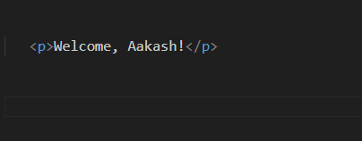
JellyScript Syntax
4. Variable and with condition as choose and when
<?xml version="1.0" encoding="utf-8" ?>
<j:jelly trim="false" xmlns:j="jelly:core" xmlns:g="glide" xmlns:j2="null" xmlns:g2="null">
<j:set var="jvar_name" value="Aakash">
</j:set>
<j:choose>
<j:when test="${jvar_name eq 'Richa'}">
<p>Welcome, Richa!</p>
</j:when>
<j:when test="${jvar_name eq 'Atul'}">
<p>Welcome, Atul!</p>
</j:when>
<j:otherwise>
<p>Welcome, ${jvar_name}!</p>
</j:otherwise>
</j:choose>
</j:jelly>
Output:
Notes:
https://medium.com/@aakashgarg3108/introduction-to-servicenow-jelly-scripting-509a51c64147

Slide 27
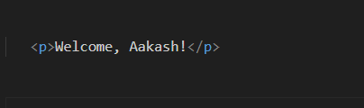
JellyScript Syntax
5. Switch/case.
<?xml version="1.0" encoding="utf-8" ?>
<j:jelly trim="false" xmlns:j="jelly:core" xmlns:g="glide" xmlns:j2="null" xmlns:g2="null">
<j:set var="jvar_name" value="Aakash">
</j:set>
<j:switch on="${jvar_name}">
<j:case value="Richa">
<p>Welcome, Richa!</p>
</j:case>
<j:case value="Atul">
<p>Welcome, Atul!</p>
</j:case>
<j:default>
<p>Welcome, ${jvar_name}!</p>
</j:default>
</j:switch>
</j:jelly>
Output:
Notes:
https://medium.com/@aakashgarg3108/introduction-to-servicenow-jelly-scripting-509a51c64147

Slide 28
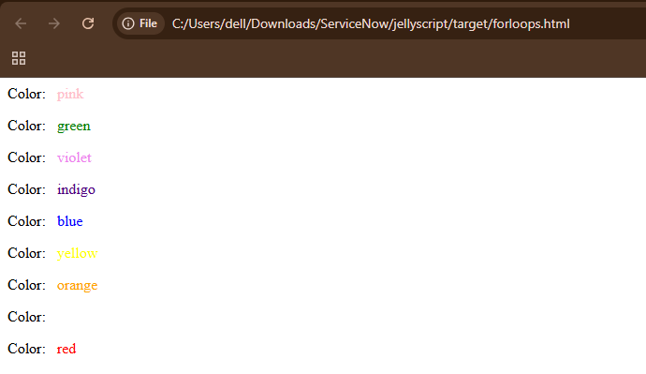
JellyScript Syntax
6. Loops
<?xml version="1.0" encoding="utf-8" ?>
<j:jelly trim="false" xmlns:j="jelly:core">
<!-- Standard Jelly uses <j:set> to define variables.
We split a string to create an iterable array. -->
<j:set var="colors" value="pink,green,violet,indigo,blue,yellow,orange,white,red"/>
<j:forEach var="jvar_colors" items="${colors.split(',')}">
<p>Color: &#160; <span style="color:${jvar_colors}">${jvar_colors}</span></p>
</j:forEach>
<j:forEach var="jvar_index" begin="0" end="20" step="2">
${jvar_index}
</j:forEach>
</j:jelly>
Output:
Notes:
https://medium.com/@aakashgarg3108/introduction-to-servicenow-jelly-scripting-509a51c64147

Slide 29
JellyScript Syntax
Some Examples:
<?xml version="1.0"?>
<j:jelly xmlns:j="jelly:core">
<!-- Set a variable -->
<j:set var="name" value="Alice"/>
<j:set var="age" value="20"/>
<!-- If condition -->
<j:if test="${age >= 18}">
<j:expr value="Hello ${name}, you are an adult."/>
</j:if>
<br/>
Output:
Notes:
https://medium.com/@aakashgarg3108/introduction-to-servicenow-jelly-scripting-509a51c64147
https://commons.apache.org/proper/commons-jelly/tags.html

Slide 30

JellyScript Syntax
<!-- Choose / When / Otherwise -->
<j:choose>
<j:when test="${age &lt; 13}">
Child
</j:when>
<j:when test="${age &lt; 20}">
Teenager
</j:when>
<j:otherwise>
Adult
</j:otherwise>
</j:choose>
Some Examples:
Output:
Notes:
https://medium.com/@aakashgarg3108/introduction-to-servicenow-jelly-scripting-509a51c64147
https://commons.apache.org/proper/commons-jelly/tags.html

Slide 31
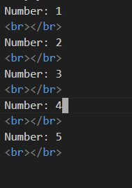
JellyScript Syntax
Some Examples:
<!-- Loop example -->
<j:set var="numbers" value="1,2,3,4,5"/>
<j:forEach var="num" items="${numbers}">
Number: ${num}
<br/>
</j:forEach>
Output:
Notes:
https://medium.com/@aakashgarg3108/introduction-to-servicenow-jelly-scripting-509a51c64147
https://commons.apache.org/proper/commons-jelly/tags.html

Slide 32
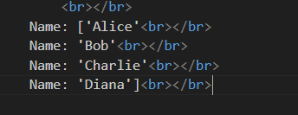
JellyScript Syntax
<!-- For array -->
<j:set var="names" value="['Alice', 'Bob', 'Charlie', 'Diana']"/>
<j:forEach var="currentName" items="${names}">
Name: ${currentName}<br/>
</j:forEach>
Output:
Notes:
https://medium.com/@aakashgarg3108/introduction-to-servicenow-jelly-scripting-509a51c64147
https://commons.apache.org/proper/commons-jelly/tags.html

Slide 33
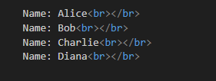
JellyScript Syntax
<!-- Create Java ArrayList -->
<j:new className="java.util.ArrayList" var="names"/>
<j:invoke on="${names}" method="add">
<j:arg value="Alice"/>
</j:invoke>
<j:invoke on="${names}" method="add">
<j:arg value="Bob"/>
</j:invoke>
<j:invoke on="${names}" method="add">
<j:arg value="Charlie"/>
</j:invoke>
<j:invoke on="${names}" method="add">
<j:arg value="Diana"/>
</j:invoke>
<!-- Loop through it -->
<j:forEach var="currentName" items="${names}">
Name: ${currentName}<br/>
</j:forEach>
Output:
Notes:
https://medium.com/@aakashgarg3108/introduction-to-servicenow-jelly-scripting-509a51c64147
https://commons.apache.org/proper/commons-jelly/tags.html

Slide 34
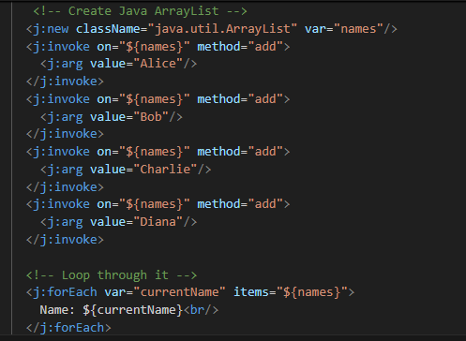
JellyScript Syntax
<j:new> creates a new Java object instance
className="java.util.ArrayList" specifies we want to create an ArrayList (a Java collection that can hold multiple items)
var="names" stores this new ArrayList in a variable called names
This is like doing ArrayList names = new ArrayList(); in Java
Let's break down the first <j:invoke>:
<j:invoke> calls a method on an existing Java object
on="${names}" specifies which object to call the method on (our ArrayList)
method="add" specifies we want to call the add() method
Inside, <j:arg value="Alice"/> provides the argument/parameter for the method
This is like doing names.add("Alice"); in Java
Notes:
https://medium.com/@aakashgarg3108/introduction-to-servicenow-jelly-scripting-509a51c64147
https://commons.apache.org/proper/commons-jelly/tags.html

Slide 35
JellyScript Syntax
<!-- Parse String -->
<j:set var="nameString" value="Alice,Bob,Charlie,Diana"/>
<j:set var="names" value="${nameString.split(',')}"/>
<j:forEach var="currentName" items="${names}">
Name: ${currentName}<br/>
</j:forEach>
Output:
Notes:
https://medium.com/@aakashgarg3108/introduction-to-servicenow-jelly-scripting-509a51c64147
https://commons.apache.org/proper/commons-jelly/tags.html

Slide 36

JellyScript Syntax
<!-- Create a Date object (current date/time) -->
<j:new className="java.util.Date" var="now"/>
Current date/time: ${now}<br/>
<!-- Get timestamp in milliseconds -->
<j:invoke on="${now}" method="getTime" var="timestamp"/>
Timestamp: ${timestamp} milliseconds<br/>
<!-- Format the date -->
<j:new className="java.text.SimpleDateFormat" var="formatter">
<j:arg value="yyyy-MM-dd HH:mm:ss"/>
</j:new>
<j:invoke on="${formatter}" method="format" var="formattedDate">
<j:arg value="${now}"/>
</j:invoke>
Formatted date: ${formattedDate}
Output:
Notes:
https://medium.com/@aakashgarg3108/introduction-to-servicenow-jelly-scripting-509a51c64147
https://commons.apache.org/proper/commons-jelly/tags.html

Slide 37
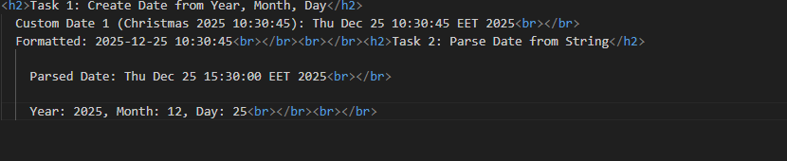
JellyScript Syntax
Task:
Create custom date not taken today
Notes:
https://medium.com/@aakashgarg3108/introduction-to-servicenow-jelly-scripting-509a51c64147
https://commons.apache.org/proper/commons-jelly/tags.html

Slide 38

static fields
<!-- Get static fields -->
<j:getStatic var="pi" className="java.lang.Math" field="PI"/>
<j:getStatic var="e" className="java.lang.Math" field="E"/>
PI value: ${pi}<br/>
E value: ${e}<br/>
Output:
Notes:
https://medium.com/@aakashgarg3108/introduction-to-servicenow-jelly-scripting-509a51c64147
https://commons.apache.org/proper/commons-jelly/tags.html

Slide 39
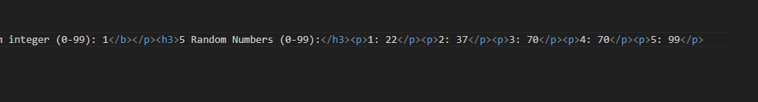
JellyScript Syntax
Task:
Try to get random number but integer
Notes:
https://medium.com/@aakashgarg3108/introduction-to-servicenow-jelly-scripting-509a51c64147
https://commons.apache.org/proper/commons-jelly/tags.html

Slide 40
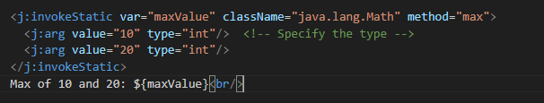
Static fields
Task
Try To get Max
Output:
Notes:
https://medium.com/@aakashgarg3108/introduction-to-servicenow-jelly-scripting-509a51c64147
https://commons.apache.org/proper/commons-jelly/tags.html

Slide 41

Static fields
Task
Try To get round
<j:invokeStatic var="rounded" className="java.lang.Math" method="round">
<j:arg value="3.14159" type="float"/>
</j:invokeStatic>
Rounded PI: ${rounded}
Output:
Notes:
https://medium.com/@aakashgarg3108/introduction-to-servicenow-jelly-scripting-509a51c64147
https://commons.apache.org/proper/commons-jelly/tags.html

Slide 42

StringBuilder
<!-- Create StringBuilder -->
<j:new className="java.lang.StringBuilder" var="builder"/>
<!-- Append strings -->
<j:invoke on="${builder}" method="append">
<j:arg value="Hello"/>
</j:invoke>
<j:invoke on="${builder}" method="append">
<j:arg value=" "/>
</j:invoke>
<j:invoke on="${builder}" method="append">
<j:arg value="World"/>
</j:invoke>
<!-- Get the final string -->
<j:invoke on="${builder}" method="toString" var="message"/>
Message: ${message}<br/>
<!-- Get length -->
<j:invoke on="${builder}" method="length" var="length"/>
Length: ${length}<br/>
<!-- Reverse it -->
<j:invoke on="${builder}" method="reverse"/>
Reversed: ${builder.toString()}
Notes:
https://medium.com/@aakashgarg3108/introduction-to-servicenow-jelly-scripting-509a51c64147
https://commons.apache.org/proper/commons-jelly/tags.html

